Slide 1

Sports Analytics IV
Produced by Dr. Mario
UNC STOR 538

Slide 2

Educating Yourself
Academic Journals in Sports
Journal of Quantitative Analysis in Sports (JQAS)
Founded by Ben Alamar in 2005
Acquired by American Statistical Association in 2011
Editor-in-Chief: Gil Fellingham
Acceptance Rate of 10.8% (Glickman 2017)
Journal of Sports Analytics
Less Consumed with Technical Skills
More Consumed with Novel Applications
Mark Cuban is Involved
Working in Sports Analytics, Tim Swartz, 2018 (Seen in The American Statistician)

Slide 3
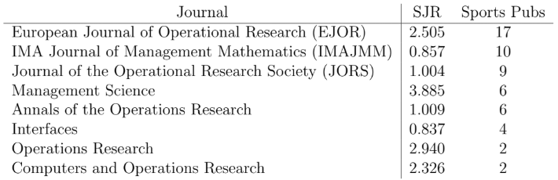
Educating Yourself
Academic Journals in Operations Research
Working in Sports Analytics, Tim Swartz, 2018 (Seen in The American Statistician)

Slide 4
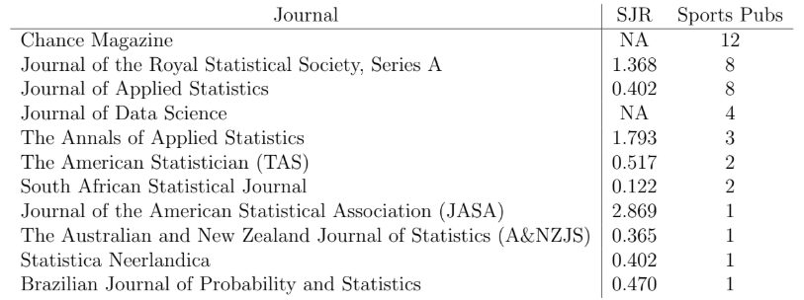
Educating Yourself
Academic Journals in Statistics
Working in Sports Analytics, Tim Swartz, 2018 (Seen in The American Statistician)

Slide 5
Educating Yourself
Special Journal Issues on Sports Analytics
Statistical Analysis and Data Mining: The ASA Data Science Journal – Volume 9, Issue 5, 2016
Data Mining and Knowledge Discovery – Volume 31, Issue 6, 2017
Electronic Journal of Applied Statistical Analysis – Volume 10, Issue 3, 2017
Machine Learning – 2018
International Journal of Forecasting - 2018
Working in Sports Analytics, Tim Swartz, 2018 (Seen in The American Statistician)

Slide 6
Educating Yourself
Academic Journals on Sports Science
Journal of Sports Science and Medicine
Journal of Sports Sciences
European Journal of Sport Science
Journal of Human Sport and Exercise
Working in Sports Analytics, Tim Swartz, 2018 (Seen in The American Statistician)

Slide 7
Educating Yourself
Miscellaneous Academic Journals on Sports
Other Journals Exist for Sports
Less Tied to Operations Research or Statistics
Examples
Sports Engineering
Sport and Society
Sport Business and Management
International Journal of Performance Analysis in Sport
International Journal of Sport Science and Coaching
International Journal of Computer Science in Sport
Working in Sports Analytics, Tim Swartz, 2018 (Seen in The American Statistician)

Slide 8
Educating Yourself
Blog Sites
General (Top 10 Using Search and Social Metrics)
Action Network
Agile Sports Analytics
Harvard College Sports Analysis
iSports Analysis
Team Sports Analysis
Stat Sheet Stuffer
Analysis Pro
MIT Sloan Experts
Five Thirty Eight
Spiideo
Aggregated on blog.feedspot.com/sports_analytics_blogs

Slide 9
Educating Yourself
Blog Sites
Basketball
Hoops Hype
82games
Squared 2020
NBA Stuffer
Baseball
Fan Graphs
Sandlot Stats
Beyond the Box Score
Baseball With R

Slide 10
Educating Yourself
Blog Sites
Hockey
Hockey Graphs
Corsica Hockey
Hockey Analytics
Football
Football Outsiders
Advanced Football Analytics
Fantasy Football Analytics

Slide 11
Educating Yourself
Blog Sites
Soccer
StatsBomb
5 Added Minutes
manVmetrics
American Soccer Analysis
Soccermetrics

Slide 12
Getting Educated
Masters Associated with Sports Analytics
Adelphi University (Online)
American University (Online)
California University of Pennsylvania (Online)
Indiana University Purdue University Indianapolis
Marquette University (Hybrid)
Northwestern University
University of North Texas
Certificates for Sports Analytics
Columbia University
Northwestern University
Wilmington University
Aggregated on discoverdatasicence.org/related-programs/sports-analytics/

Slide 13
Getting Educated
Unconventional Programs
Sports Management Worldwide
Founded by Dr. Lynn Lashbrook
Degrees
Masters of Sports Leadership
MBA in Sports Leadership
Doctorate in Sports Management
Very Flexible Course Selection
Pay by Course
Udemy
Courses Around $9.99

Slide 14
Getting Educated
PhD in Data Science
Boise State (Computer Science)
Bowling Green State University
Brown University (Computer Science)
Chapman University
Clemson (Biomedical)
George Mason University (Computer Science)
Harrisburg University of Science and Technology
Icahn School of Medicine at Mount Sinai (Biomedical)
Kennesaw State University
New Jersey Institute of Technology (Business)
New York University
Northcentral University
Aggregated on https://www.discoverdatascience.org/programs/data-science-phd/

Slide 15
Getting Educated
PhD in Data Science
University of Tennessee
University of Buffalo (Computer Science)
University of Colorado – Denver
University of Maryland
University of Massachusetts (Business)
University of Nevada – Reno
University of Southern California
University of Vermont (Engineering)
University of Washington – Seattle
University of Wisconsin – Madison (Biomedical)
Vanderbilt University (Biomedical)
Washington University in St. Louis (Computer Science)
Yale
Aggregated on https://www.discoverdatascience.org/programs/data-science-phd/

Slide 16

Educating Others
Criteria of a Good Paper
Address a Real Problem in Sports
Contain Statistical Novelty
Mainstream Adoption
Less Technical
More Visual
Focus on Less Analyzed Sports
Avoid “Black Box” Approaches
Image from en.Wikipedia.org/wiki/Black_box

Slide 17
Final Inspiration
Being a sports fan is about
embracing the accomplishments of others as if they were your own.
- Mahatma Mario

